Slide 1


Introduction to
Active Learning (AL)

Slide 2
AGENDA
Why Active Learning (AL) ?
How does an AL model work ?
Basic Query Strategies
Results on 3 datasets

Slide 3

PART I Why Active Learning ?

Slide 4

Why AL ?
Access to lots of data in many fields
But labeling is expensive and time-consuming, so a small portion of the data is labeled.
So need to focus on the most impactful data to be labeled : this is Active Learning

Slide 5
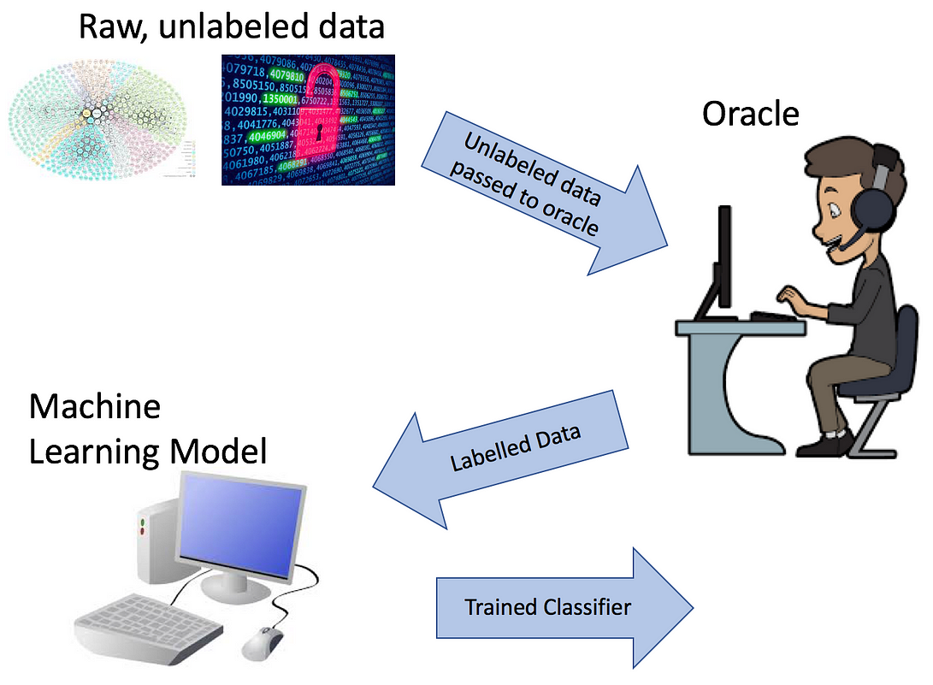
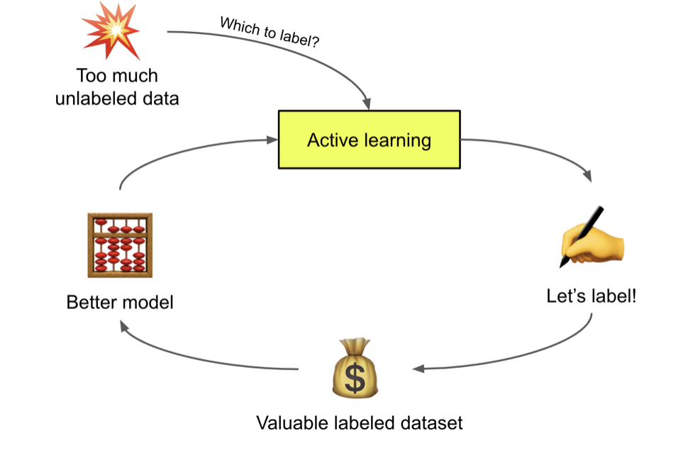
Differences ML/AL
Machine Learning (supervised)
Active Learning
Using a fixed labelled dataset to train a model
Progressive selection of the most useful unlabeled examples for the model to maximize improvement while minimizing labeling costs.

Slide 6
PART II How does an AL model work ?

Slide 7
How does an AL model work ?
A paramétrer : labeled_ratio Batch_ratio test_ratio
To be configured :
labeled_ratio
batch_ratio
test_ratio
TRAIN
POOL
TEST
Initialisation
train_ratio = labeled_ratio
pool_ratio = 1 – labeled_ratio
test_ratio : ne change pas
Sélection des données les plus incertaines
TRAIN
POOL
TEST
Après Itération 1
train_ratio = labeled_ratio + batch ratio
pool_ratio = 1 – labeled_ratio – batch_ratio
test_ratio : ne change pas
TRAIN
POOL
TEST
Après Itération i
train_ratio = labeled_ratio + i*batch ratio
pool_ratio = 1 – labeled_ratio – i*batch_ratio
test_ratio : ne change pas

Slide 8
How does an AL model work ?
Example of a dataset of 10 000 samples : test_ratio = 20% labeled_ratio = 1% Batch_ratio = 2% (Adding 160 samples at each iteration)
Initialisation
TRAIN (labeled)
POOL (unlabeled)
TEST (labeled)
80 samples
7920 samples
2 000 samples
Model Training
Selection of the most impactful data
1st iteration
TRAIN (labeled)
POOL (unlabeled)
TEST (labeled)
240 samples (80 + 160)
7 760 samples (7920 – 160)
2 000 samples
Model Retraining
Selection of the most impactful data
2nd iteration
TRAIN (labeled)
POOL (unlabeled)
TEST (labeled)
400 samples
7600 samples
2 000 samples
Model Retraining
TRAIN (labeled)
POOL (unlabeled)
TEST (labeled)
i^{th} iteration
80 + i*160 samples
7920 – i*160 samples
2 000 samples
How to select the most impactful data ?

Slide 9
PART III Basic Query Strategies

Slide 10
Random
Random :
Random selection among the samples without considering probabilities
P(Dog)
P(Cat)
P(Fox)
1
0.1
0.85
0.05
2
0.6
0.3
0.1
3
0.39
0.61
0

Slide 11

Least_confident
Least_confident :
Selection of the least confident sample according to the formula :
with x̂ the most likely class
P(Dog)
P(Cat)
P(Fox)
Uncertainty
1
0.1
0.85
0.05
1
0.15
2
0.6
0.3
0.1
2
0.4
3
0.39
0.61
0.0
3
0.39
Selection of sample 2

Slide 12

Margin
Margin :
Selection of the sample with the smallest margin between the two most likely classes
with x̂₁ and x̂₂ the 2 most likely classes
P(Dog)
P(Cat)
P(Fox)
Margin
1
0.1
0.85
0.05
1
0.75
2
0.6
0.3
0.1
2
0.3
3
0.39
0.61
0.0
3
0.22
Selection of sample 3 !

Slide 13

Entropy
Entropy :
Selection of the sample with the highest entropy according to the formula
P(Dog)
P(Cat)
P(Fox)
Entropy
1
0.1
0.85
0.05
1
0.52
2
0.6
0.3
0.1
2
0.89
3
0.39
0.61
0.0
3
0.67
Selection of sample 2 !

Slide 14
Summary of the basic QS
Formula
Pros
Cons
Random
Simple, fast, without bias
Random, can give uninformative samples
Least_confident
Effective with a few classes
Only considers the probabilities of 1 class
Margin
Effective with multi-classes
Less effective if probabilities of multiple classes are close
Entropy
Takes into account the probabilities of all classes
Harder to interpret / Less intuitive
QS to be selected depending on the use case

Slide 15
PART IV Results on 3 datasets

Slide 16
DATASETS
Description
Classes
Features
Samples
MNIST
Handwritten digit recognition
10
784
10 000
PRS
Traders’ reviews on the risk profile of players. Reduced to two classes
2
107
22 250
Foot
Prediction of players’ positions based on statistics
10
118
2 689

Slide 17
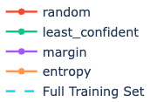
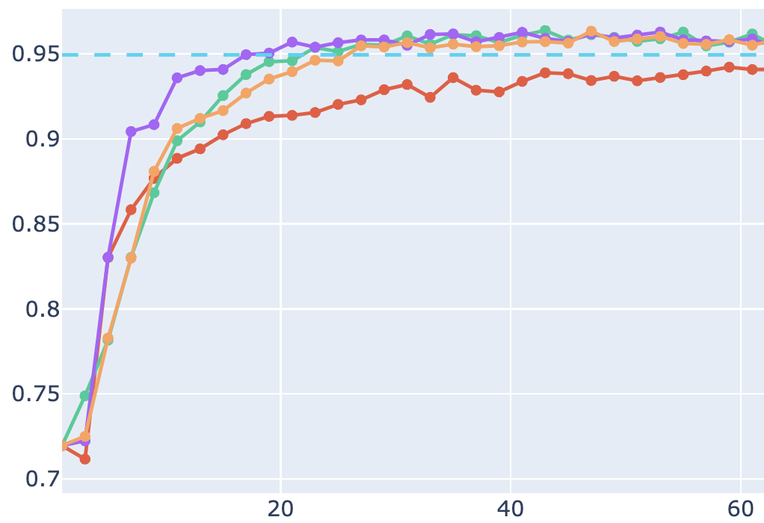
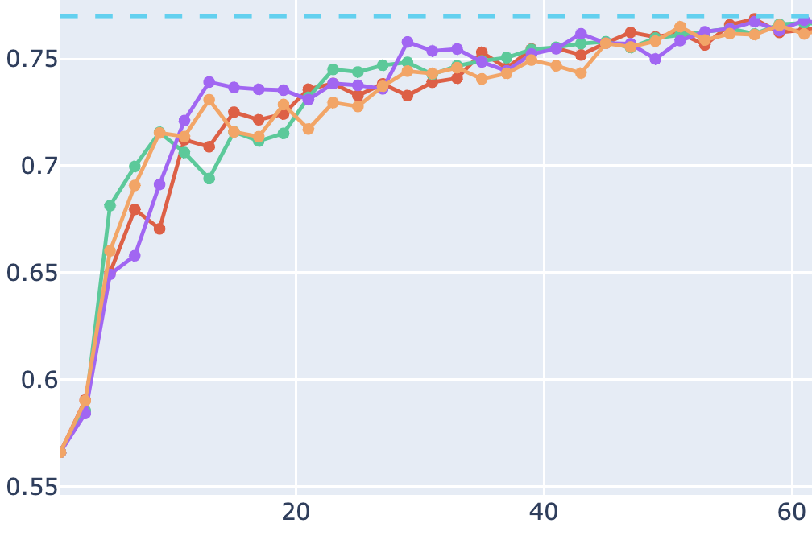
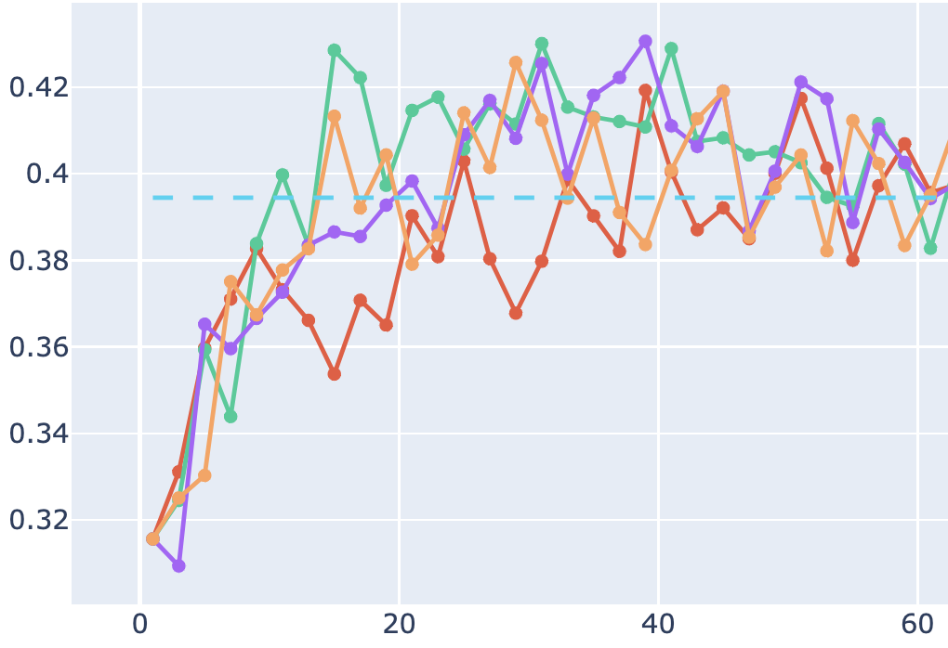
labeled_ratio = 1%
batch_ratio = 2%
test_size = 20%
First results
MNIST (F1-SCORE)
PRS (AUC P-R)
Foot (F1-SCORE)
% of training set labeled
% of training set labeled
% of training set labeled

Slide 18
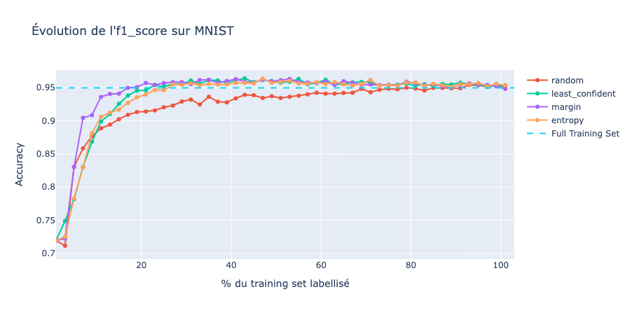

Overview of the entire labeled training set

Slide 19
Main points on Active Learning
Makes sense to use AL !

Slide 20
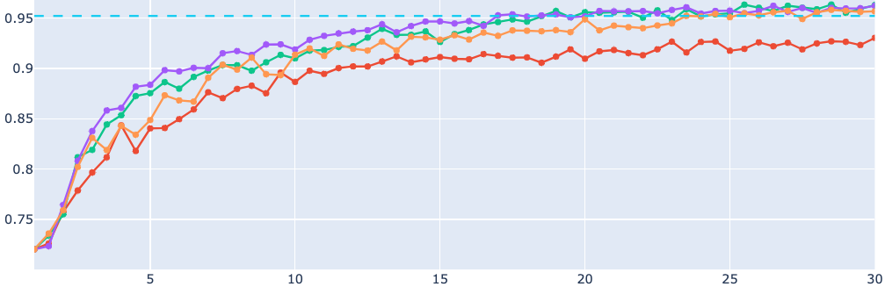
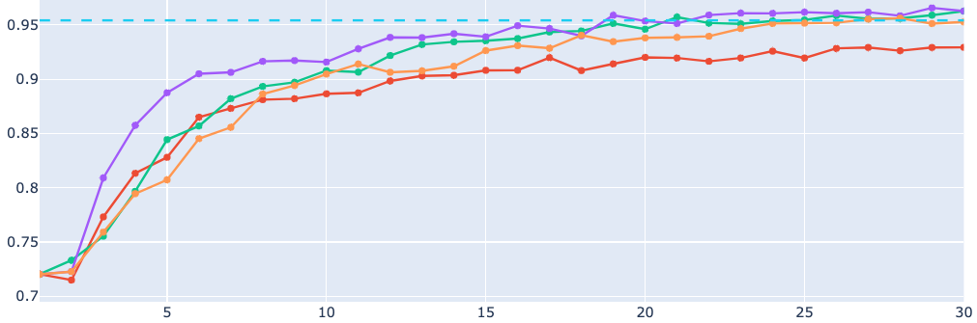
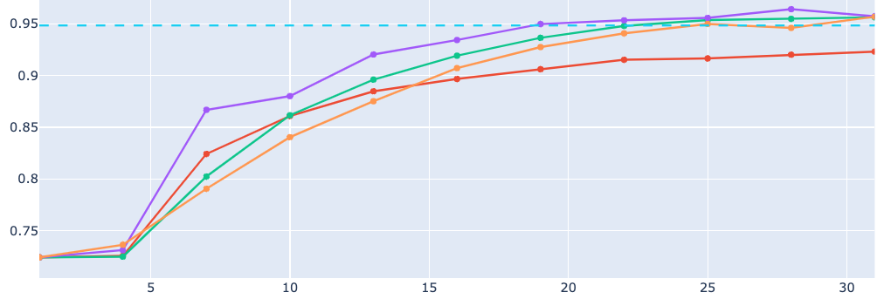
Impact of retraining on MNIST
batch_ratio = 0.5%
labeled_ratio = 1%
test_size = 20%
batch_ratio = 1%
batch_ratio = 3%

Slide 21
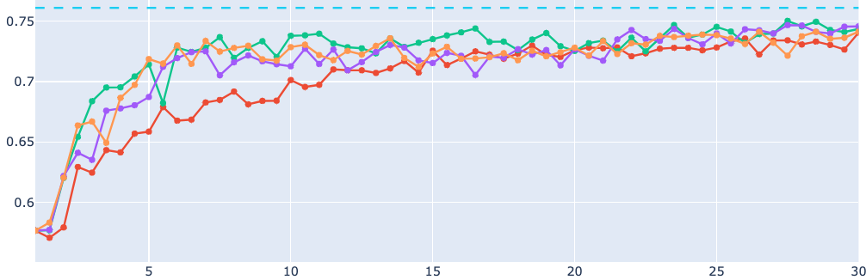
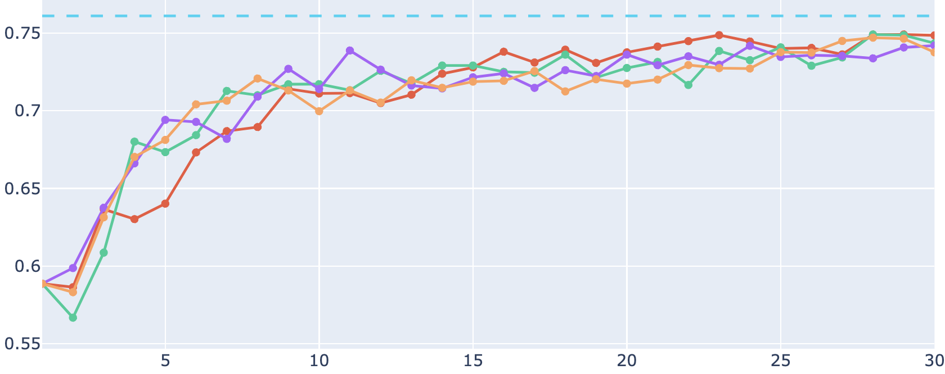
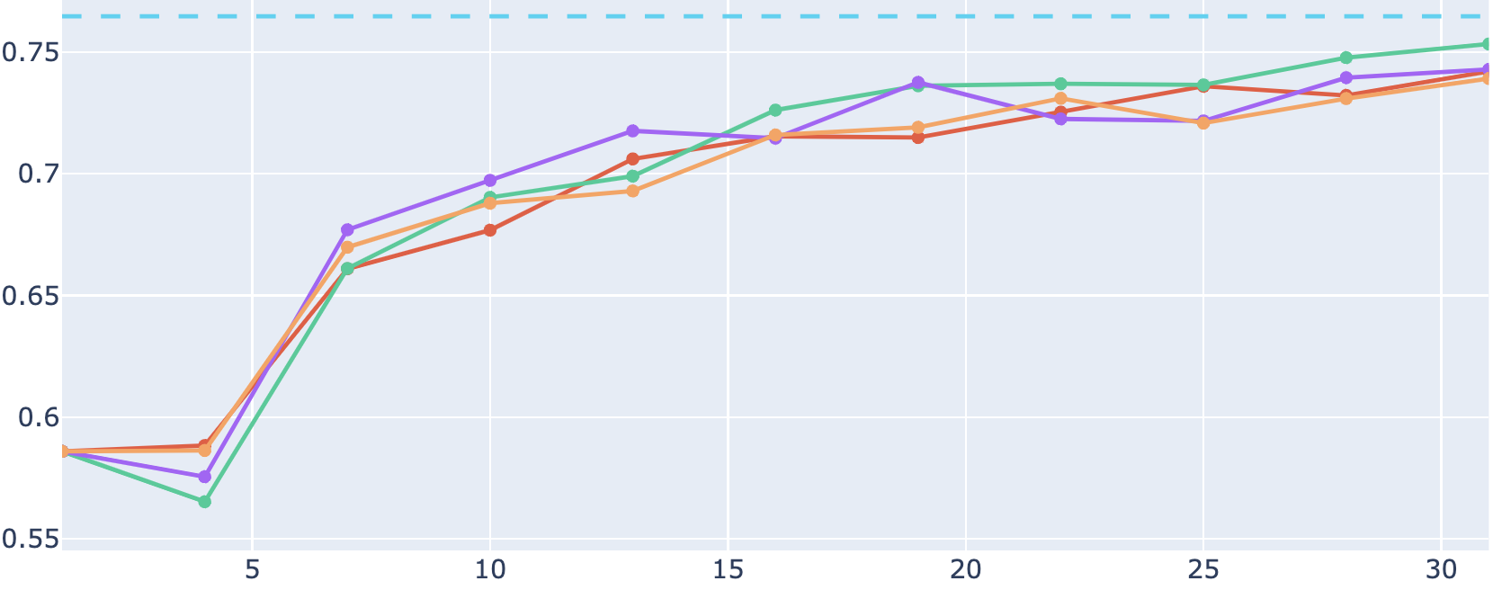
Impact of retraining on PRS
batch_ratio = 1%
batch_ratio = 0.5%
labeled_ratio = 1%
test_size = 20%
batch_ratio = 5%
batch_ratio = 1%
batch_ratio = 10%
batch_ratio = 3%

Slide 22
Main points on Active Learning
Makes sense to use AL !
The more often we retrain, the better

Slide 23
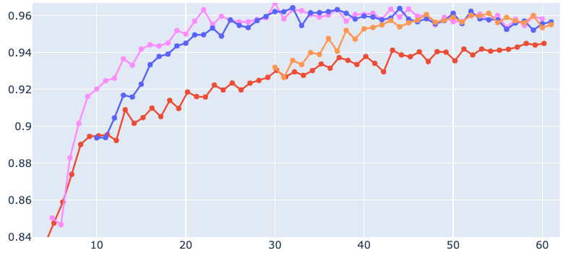
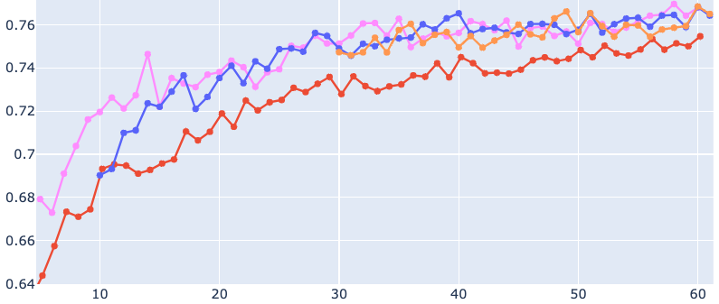
batch_ratio = 1%
test_size = 20%
Impact of initial %
MNIST (F1-SCORE)
PRS (AUC P-R)
Margin with labeled_ratio :
random
5%
10%
30%

Slide 24
Main points on Active Learning
Makes sense to use AL !
The more often we retrain, the better
Best model with AL even if high labeled ratio

Slide 25
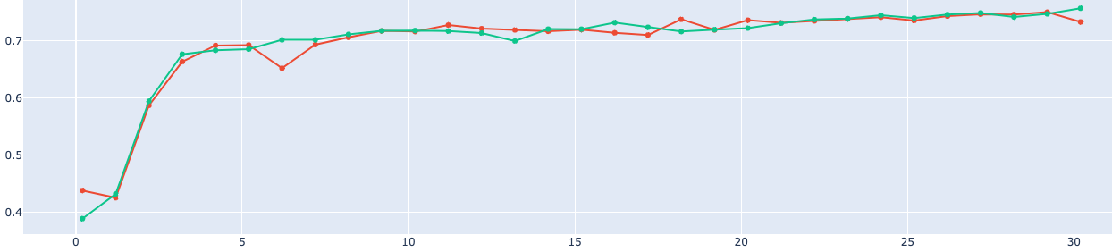
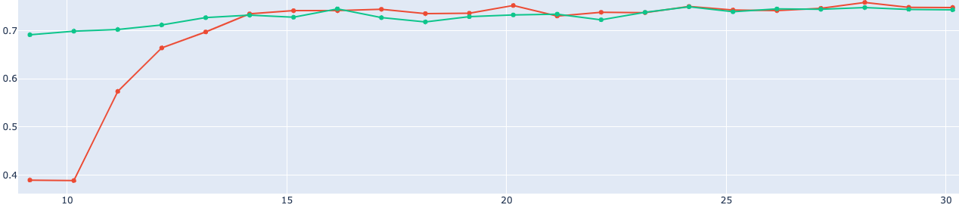

Impact of bias on PRS
batch_ratio = 1%
test_size = 20%
labeled_ratio = 0.2%
Only Original_Flag=1 in labeled_ratio
labeled_ratio = 9.15%

Slide 26
Main points on Active Learning
Makes sense to use AL !
The more often we retrain, the better
Best model even if high labeled ratio
AL can adjust to bias instead of getting locked in it

Slide 27
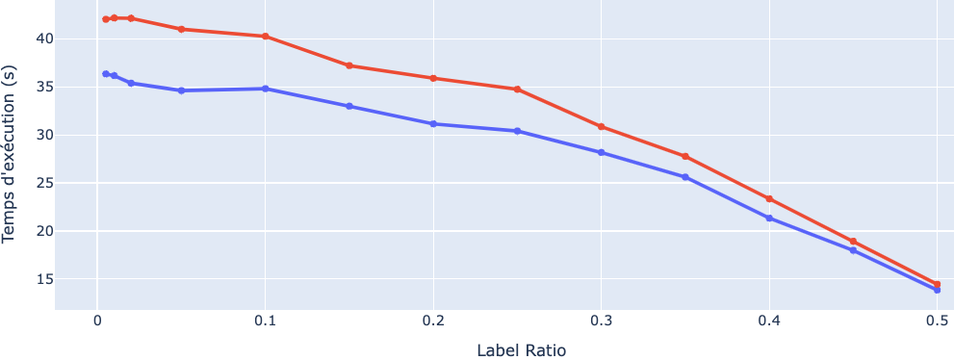

Limit = 60%
batch_ratio = 1%
test_size = 20%
Execution time
MNIST (F1-SCORE)

Slide 28
Main points on Active Learning
Makes sense to use AL !
The more often we retrain, the better
Best model even if high labeled ratio
AL can adjust to bias instead of getting locked in it
Basically same time for these BASIC QS

Slide 29
Next Steps
Test on the full PRS dataset with 3 classes
How to evaluate a QS in prod ?
Iterate on new QS more advanced

Slide 30



THANKS!

Slide 31
Itération 1 :
Si on teste 4 QS (random/LC/Margin/entropy) : sur 100 reviews envoyées on envoie 25 de chaque. On envoie les plus incertaines.
On divise notre modèle en 4 et chaque partie du modèle ne reçoit les reviews labellisées que d’une QS.
On retrain chaque partie du modèle
Itération 2 :
Pour chaque sample chaque partie du modèle renvoie des probas
Sample | P random | P LC | P margin | P entropy | QS retenu | Moy | Var
614 | 0,80 | 0,92 | 0,90 | 0,85 | P LC | 0,865 | 0,003
615 | 0,9 | 0,91 | 0,9 | 0,92 | P entropy | 0,907 | 0,000
616 | 0,9 | 0,9 | 0,9 | 0,9 | P random | 0,900 | 0,000
617 | 0,7 | 0,8 | 0,9 | 0,99 | P entropy | 0,833 | 0,016
618 | 0,3 | 0,7 | 0,9 | 0,4 | P margin | 0,47772512 | 0,07583333
On sélectionne les 25 review samples par QS avec P_QS et variance max (ou P_QS> threshold?). Si review positif on donne une score de + Var. sinon – var ?
On retrain chaque partie du modèle avec seulement les 25 reviews correspondantes.
Itération 3 : Itération 1
Itération 4 : Itération 2

